Slide 1
CIE202 Project
Example Scenario
(Page 8 in project document)

Slide 2
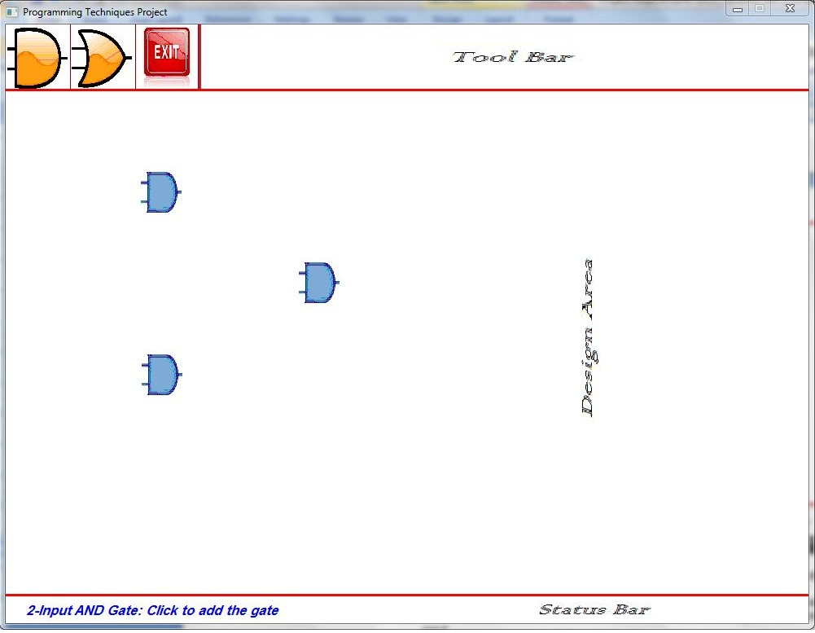
Drawing 2-input AND gate User Perspective
Application is waiting for user action
User clicks on AND2 icon
Message appears on status bar
User selects a point to draw at
Component is drawn

Slide 3
Steps to execute ANY operation Program Perspective
4 basic steps to execute any operation:
Step I: Get User Input & Map to Action Name
Step II: Create Corresponding Action Object
Step III: Execute the Created Action
Now Action is complete but not reflected yet to interface
Step IV: Update Interface

Slide 4
Drawing 2-input AND gate Operation Program Perspective
Step I: Get User Input & Map to Action Name
User clicks on AND2 icon in menu
UI class maps it to ADD_AND_GATE_2 action (enum)
Step II: Create Corresponding Action Object
Create Object of class AddANDgate2 Action
Step III: Execute the Created action
Ask user to click where he needs new AND gate to be drawn
Create Object of AND2 Component
Add AND2 object to the list of Components
Step IV: Update Interface
For each component in the list, call Draw function
Each Component calls the appropriate draw function from UI class

Slide 5
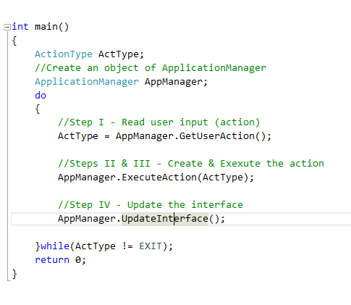
Step I: Get user input

Slide 6

Step I: Get user input
ActionType:
ADD_AND_GATE_2
6
Main
Application Manager
AppManager->GetUserAction();
1
5
ActionType:
ADD_AND_GATE_2
2
pUI->GetUserAction()
Click AND2 icon
3
WaitMouseClick()
UI
Area Checking &
Action Recognition
4
(x, y)
Click Position

Slide 7
Step II: Create a suitable action Step III: Execute the action

Slide 8
Step II: Create corresponding action
1
AppManager.ExecuteAction(ADD_AND_GATE_2);
Main
Application Manager
3
pAct->Execute(); //Action::Execute //is a pure virtual fn.
Action* pAct = NULL; //polymorphism
//switch-case ➔ create the action pAct = new AddANDgate2(this);
AddANDgate2
Action
(derived class)
2

Slide 9

Step III: Execute the action (1/2) AddANDgate2::ReadActionParameters()
pUI->PrintMessage(message);
//to print message on status bar
AddANDgate2
Action
(derived class)
1
UI
2
Print message on status bar:
…….. click to add the gate
3
pUI->GetPointClicked();
6
(a, b)
4
WaitMouseClick(x, y)
UI
User clicks at required
gate location say(a,b)
(a, b)
Gate Position
5

Slide 10
Step III: Execute the action (2/2) AddANDgate2::Execute()
2
pManager-> AddComponent(pCmp)
//ask the App. manager to add the gate
to the list of Components CompList
//polymorphism: Component * CompList[MaxCount];
Application Manager
CompList[ ]
AddANDgate2
Action
(derived class)
//Create AND2 Component
//calculate Component GfxInfo from clicked (a,b)
pA = new AND2(GfxInfo, AND2_FANOUT);
Component
Component *
Component *
Component *
Component *
Component *
Component *
1
AND2
Component
(derived class)

Slide 11
Step IV: Reflect the action to the Interface

Slide 12
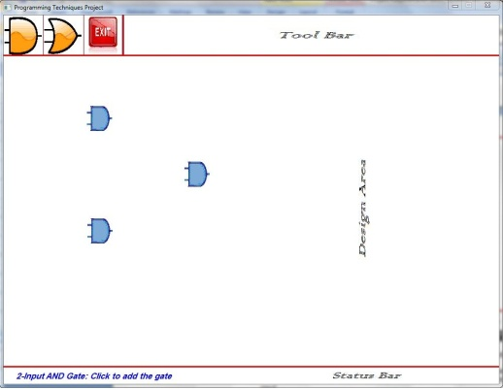
Step IV: Reflect the action to the Interface
Main
1
AppManager.UpdateInterface();
Application Manager
CompList [ ]
2
Component *
Component *
Component *
Component *
Component *
Component *
Component *
AND2
Component
(derived class)
3
pUI->DrawAND2(…);
UI
AND2
Component is drawn
For each comp. in the list
CompList[i]->Draw(pUI);
//Component::Draw() //is a pure virtual fn.
2
4

Slide 13
Thank You ☺

